Slide 1
Pragmatic approach to writing and maintaining tests
Marek Dominiak
marek.dominiak@gmail.com
#JDD_Krakow

Slide 2
Agenda
Observation
Maintaining tests with time is getting harder and harder
What can go wrong?
How to deal with “challenges”
#JDD_Krakow
Notes:
Inne prawa dla kodu testow i produkcyjnego

Slide 3

Observation: In a big project writing and maintaining tests...
Is getting harder and harder
It’s getting more costly
And in some projects it can became a
sophisticated sado-maso game for programmers
#JDD_Krakow

Slide 4

Why do we want to write tests?
Duh! Is it really necessary to explain this in 2017?
Regression
Refactoring
Fast feedback *
Check correctness of code
Good tool for checking quality
of the production code
It’s cool not to switch job
every 1.5 years
Testing live on production
#JDD_Krakow

Slide 5
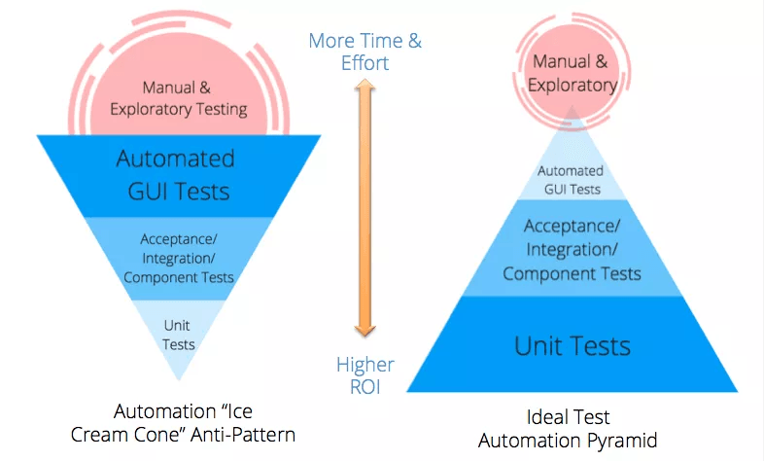
Revered test pyramid
GOOD!
BAD!
#JDD_Krakow
Source: http://www.abstracta.us/2015/10/26/best-testing-practices-for-agile-teams-the-automation-pyramid/
Notes:
Pozniej opowiemy sobie jak dochodzi do ani patternu odwroconej piramidy

Slide 6

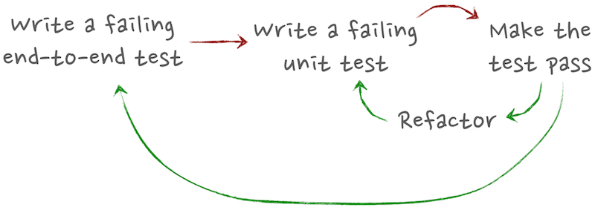
BDD in practice
Source: http://megakemp.com/2014/04/24/bdd-all-the-way-down/
#JDD_Krakow
Notes:
Leading test - Uzytkownik sie rejestruje,
Moze sie zalogowac na konto
I widzi homepage
I dostaje email potwierdzajacego rejstracje
1,3,15 testow

Slide 7
How many tests to write?*
Unit - 80-90% of all tests
Integration - 5-15%
Acceptance - 1-5%
Manual - 0% xD
* Of course, it depends on the project. This is just an example. Pick your own ratios consciously and you will be fine
#JDD_Krakow
Notes:
Nie wszystkie moduly sa rowne, niektore sa wazniejsze

Slide 8
What problems do you have with your unit tests?
They don’t test important functions (they should test Core domain)
They are hard to write
It's hard to read them - too much magic
They are unstable
There are slow
Too many mocks are needed!
#JDD_Krakow

Slide 9
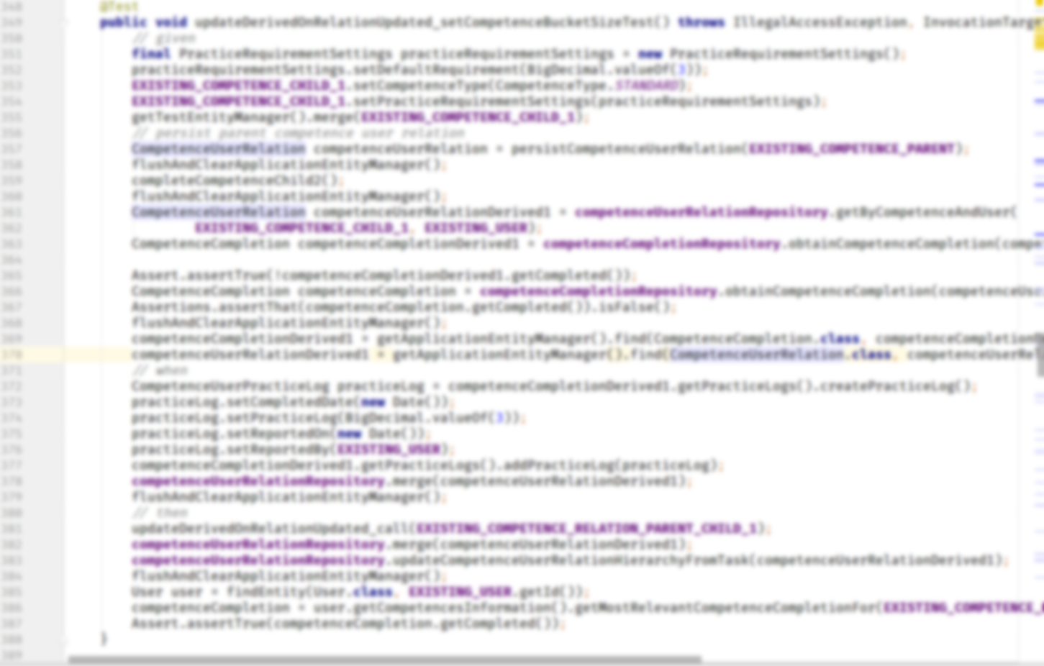
Example of a bad test
#JDD_Krakow

Slide 10
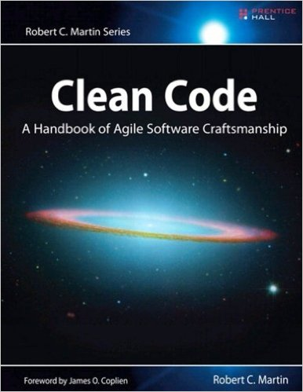

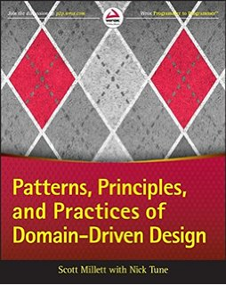

Problem - Unit test is hard to write
How to fix it?
Use Test builders
Refactor test and production code (Clean code)
Redesign the production code (Solid, GRASP, DDD, CQRS,
Hexagonal architecture)
Use mock-s / s-stub if necessary (Mockito)
#JDD_Krakow

Slide 11
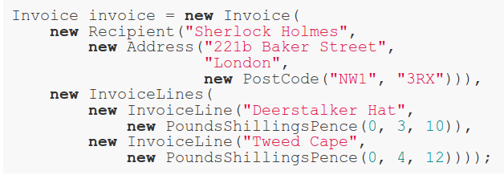


Test builders
BAD!
Object with predefined values.
Customized object
GOOD!
#JDD_Krakow
Source: http://www.natpryce.com/articles/000714.html http://www.natpryce.com/articles/000726.html

Slide 12
Problem: they are too hard to read
How to fix it?
Inline setup
Use Test builders
Expect literals
Remove loop from test code → use parametrized tests (testng, spock, Junit params)
One assert per test
Assert for exceptions - Assertions.assertThatThrownBy(..)
Don’t use @Test(excepted=). Junit 5 comes with assertThrows
#JDD_Krakow
Notes:
Test and production code have different laws

Slide 13
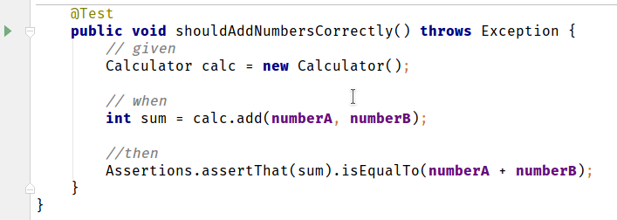
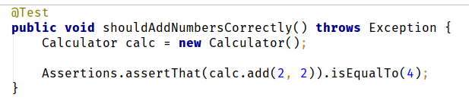
Expect literals
BAD!
GOOD!
#JDD_Krakow
Notes:
Maybe magic numbers are ok in tests.
DRY

Slide 14
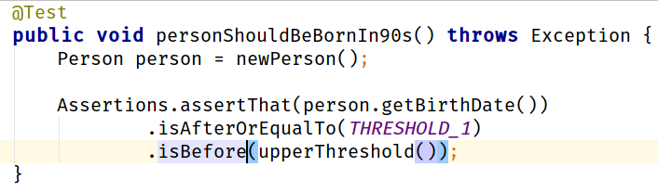
Inline setup, expected literals
#JDD_Krakow

Slide 15
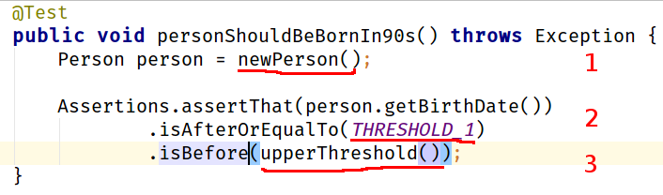
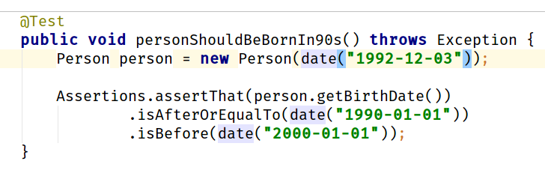
Inline setup, expected literals
VERY BAD!
GOOD!
#JDD_Krakow

Slide 16
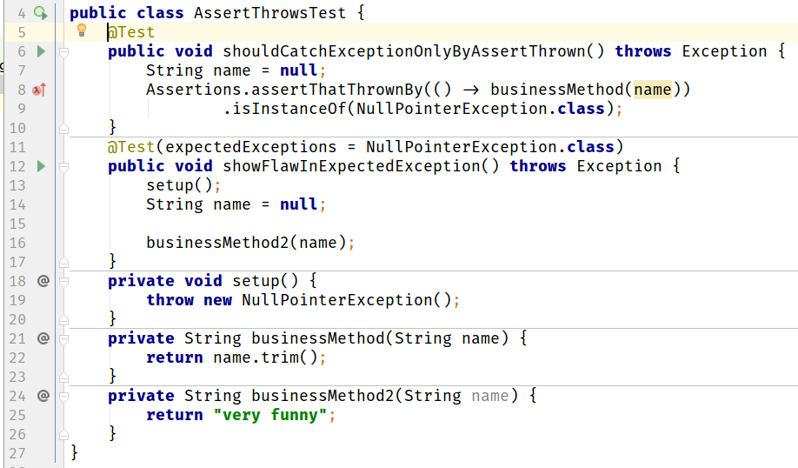
What is wrong with Expected exception?
#JDD_Krakow

Slide 17
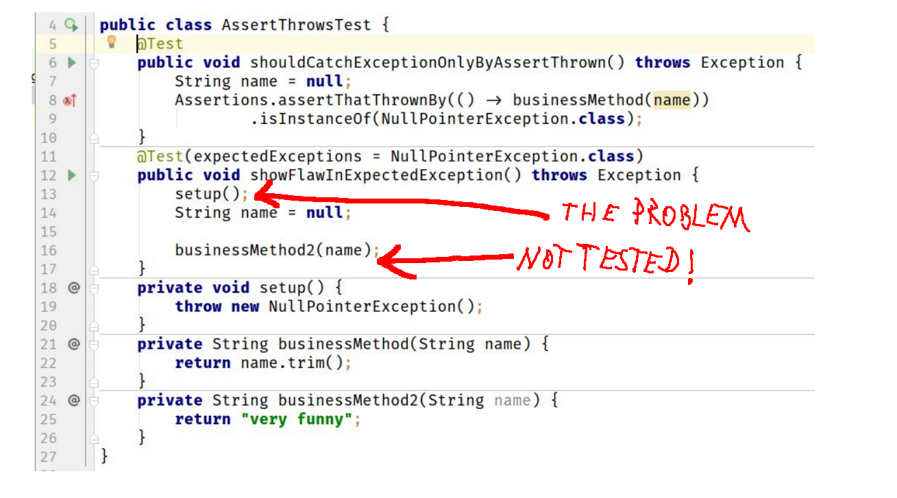
What is wrong with Expected exception?
GOOD!
BAD!
#JDD_Krakow

Slide 18

Problem: they are unstable
How to fix it?
The tests should test a single behavior - one
reason to fail
Do not rely too much on DRY, use DAMP instead →
(Descriptive And Maintainable Procedures)
Avoid inheritance hierarchy of classes of tests
Operations on dates/time -> in production code
use Clock instead of LocalDateTime.now() or new Date()
ThreadLocal variables not cleaned between tests
#JDD_Krakow

Slide 19


Problem: they are slow
BAD!
GOOD!
#JDD_Krakow

Slide 20
Problem: they are slow
How to fix it?
Delete sleep-s from code - Use Clock instead (see example SessionRegistryImplTests.java)
Make sure tests do not use external resources (e.g. they do not touch the file system etc.). All external resources should be mocked
#JDD_Krakow
Notes:
Co moze byc zepsute bedzie zepsute

Slide 21
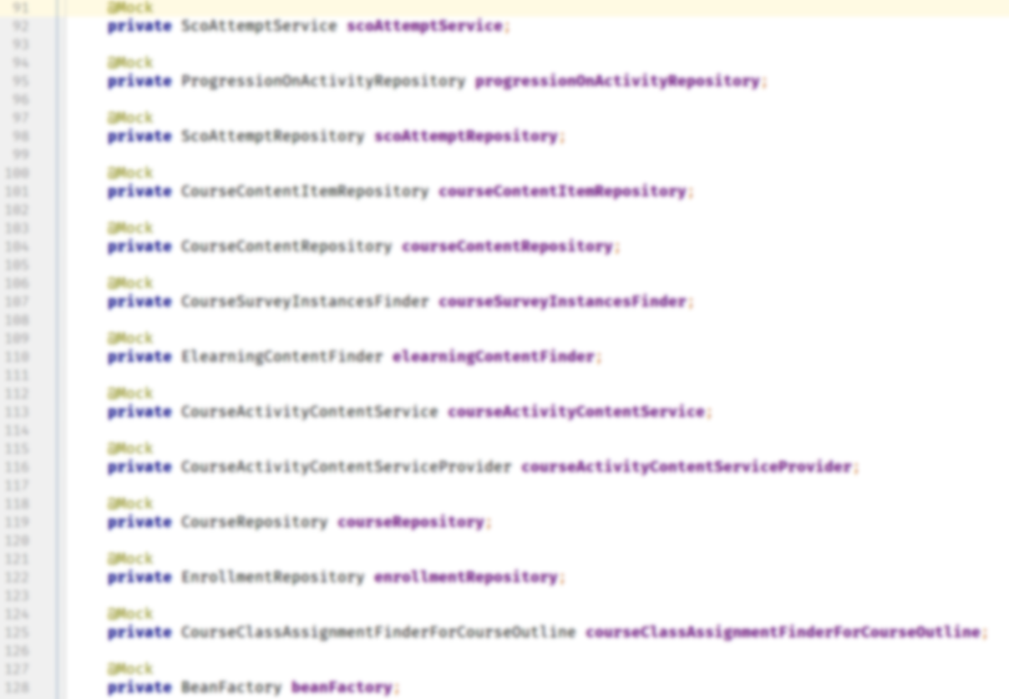
Too many mocks!
#JDD_Krakow

Slide 22
Problem: too many mocks!
How to fix it?
Redesign production code if not too late…
  Use SRP - Single Responsibility Principle
  SOLID Principles
  GRASP - General Responsibility Assignment Software Patterns
  DDD - Domain Driven Design
  CRQS - Command Query Responsibility Segregation
  ES - Event Sourcing
  Microservices
Probable cause: too many Bounded Contexts mixed together
#JDD_Krakow

Slide 23
Characteristics of good unit tests
Fast
Independent (they do not rely too much on DRY)
Stable
Easy to read
Easy to write -> to get high ROI (Return Of Investment)
Testing only one behavior - only one reason to fail
#JDD_Krakow
Notes:
Cechy

Slide 24
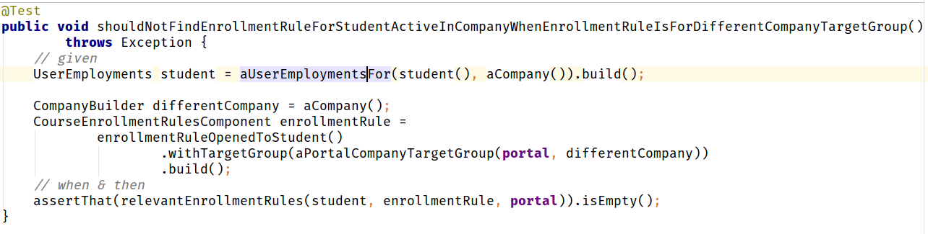
Example of a good unit test
#JDD_Krakow

Slide 25
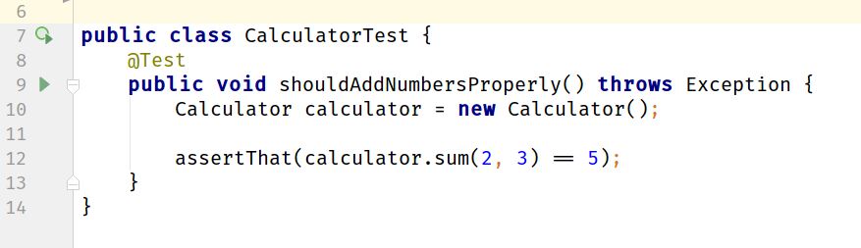
Can you spot what is wrong with this test?
This test is always green
There are no assertions here
#JDD_Krakow

Slide 26
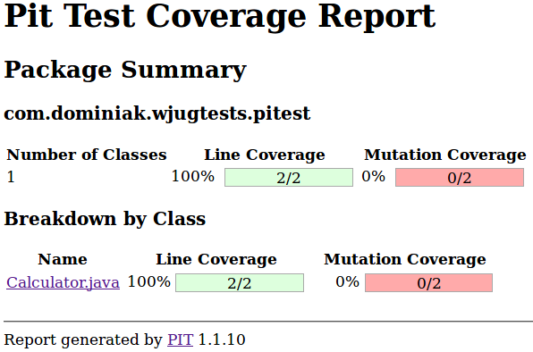
Mutation testing (Pitest) to the rescue!
#JDD_Krakow

Slide 27
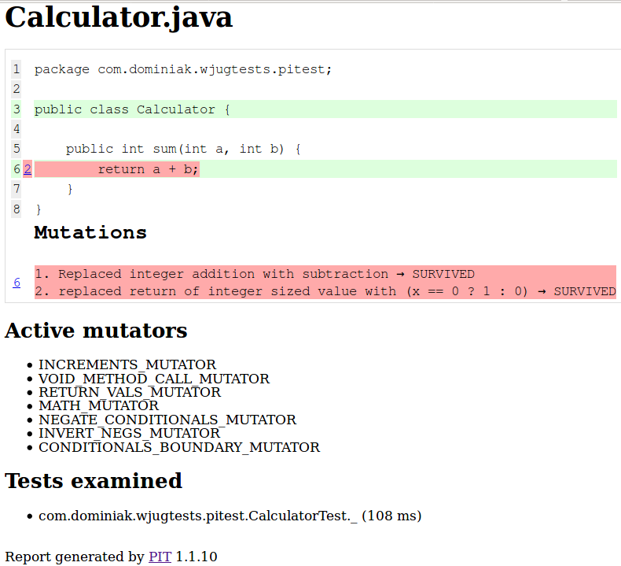
Mutation testing (Pitest) to the rescue!
#JDD_Krakow

Slide 28

Why do we need integration tests?
#JDD_Krakow

Slide 29
What can go wrong with integration tests?
They are very slow ...
They are very unstable
They are hard to read
Too many false - positives
#JDD_Krakow

Slide 30

Problem with integration tests: they are slooow!
How to fix it? A couple of quick hacks:
Remove the “sleeps” from tests
Use SSD / RAM disk for /tmp, database
Remove unnecessary logging
Smoke tests for configuration (database etc.)
Be aware of how many application contexts are
created (be aware of @MockBean!)
Make them run in parallel
#JDD_Krakow
Source: https://vladmihalcea.com/2016/04/11/how-to-run-database-integration-tests-20-times-faster/
Notes:
Sprawdz czy Smoke test. Fail fast
Smoke test of configuration

Slide 31
Problem with integration tests: they are slooow!
How to fix it? Solutions requiring more work
Are integration tests testing what unit tests should?
Does your tests structure looks like on Reversed
Test Pyramid?
Redesign production code so unit tests
are easier to write
Perhaps the project has expanded too much?
Introduce modularization, Bounded
Contexts -> Domain Driven Design
#JDD_Krakow

Slide 32

Problem: Integration tests are unreliable
How to fix it?
Make sure operations on time
don’t compare to the milliseconds
Remove the "flickering" tests
Provide the same environment for
tests - "Works for me", e.g.
a database on docker.
#JDD_Krakow

Slide 33
Problem: Integration tests are unreliable 2
How to fix it? Mock/Fake external resources
FileSystem (for nio - Jimfs, Apache
Commons VFS)
Date / Time (use Clock, JodaTime -
org.joda.time.DateTimeUtils#setCurrentMillisFixed),
Database (in memory databases like H2, hsql,
Fongo for MongoDB)
MailServer (Greenmail),
FTP server (MockFTPServer),
HTTP (okhttp, Wiremock)
Consumer Contract Testing - Spring Cloud Contract, Pact
#JDD_Krakow

Slide 34
Problem: Integration tests are hard to read
How to fix it?
The same tips as for unit tests applies for integration tests
Avoid inheritance hierarchy - use @Rule Junit 4 and from Junit 5 Extensions when you need some customisation
#JDD_Krakow

Slide 35
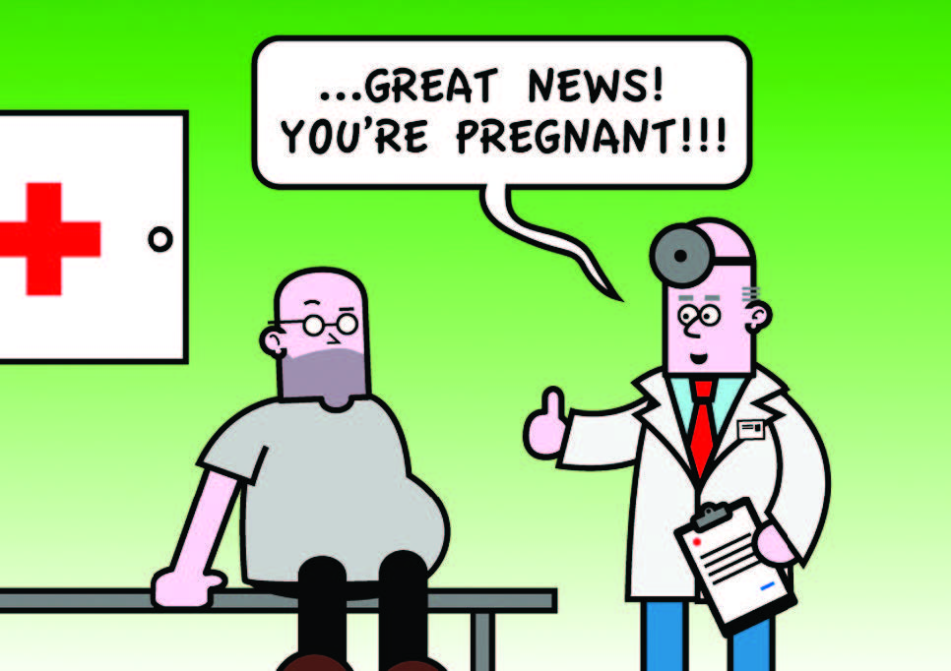
Problem: too many false-positives
Transactional tests pitfalls
There is always a transaction
You won’t get any LazyInitializationExceptions
If you forgot to open a transaction in prod
code your test won’t throw any errors
You can’t use your DB client to see what is
in the database
Source: http://www.nurkiewicz.com/2011/11/spring-pitfalls-transactional-tests.html http://blog.myesr.org/wp_live_esr11_23zcq/wp-content/uploads/2014/03/p9_Sunday_SF15b_Figure-1-cartoon-FP.jpg
#JDD_Krakow

Slide 36
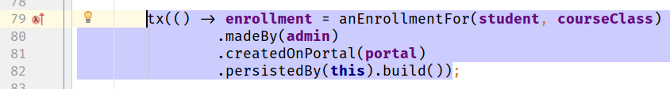
Problem: too many false-positives
How to fix?
Non-transactional tests*
* This is not a silver bullet - they are slower, we must remove data after each test, worse parallelism
Source: http://www.nurkiewicz.com/2011/11/spring-pitfalls-transactional-tests.html
#JDD_Krakow

Slide 37


Two words about Spock
Spock == Mockito + Junit 5 + more
Perfect for BDD, (given, when then)
Nice assertions
Perfect for parameterized tests
Easier operations on text
Pivotal Support, good Spring support, uses JUnit runner
It’s not a silver bullet but in some cases
can be more effective than Junit 5
#JDD_Krakow

Slide 38
Before you go
Check if you can remove the initial end-to-end "leading" tests
Remove ignored tests
Remove flickering tests
Ask yourself if you really need this test?
Remember about Reversed Test Pyramid
Test behavior, not implementation
Listen to “tests”, hard to read/write => production code sucks
Use the right tool for the job
Divide and conquer if still possible. If not change job :P
#JDD_Krakow

Slide 39
Tools
Unit testing: Junit, testng, Spock, Mockito, AssertJ, Truth
Mutation testing: Pitest
Integration testing: SpringTest
End-to-end Testing: WebDriver - Selenium, Geb
Performance testing: JMeter, gatling, apache-bench
BDD testing frameworks: Cucumber, JBehave
Other tools: Awaitility *, Powermock *
#JDD_Krakow

Slide 40
Books, links, sources
Practical Unit Testing with TestNG and Mockito - Tomek Kaczanowski
Working Effectively with Unit Tests - Jay Fields
Growing Object-Oriented Software, Guided by Tests - Nat Pryce, Steve Freeman
http://www.abstracta.us/2015/10/26/best-testing-practices-for-agile-teams-the-automation-pyramid/
http://www.slideshare.net/wakaleo/bdd-the-unit-test-of-the-product-owner
http://www.natpryce.com/articles/000714.html
https://vladmihalcea.com/2016/04/11/how-to-run-database-integration-tests-20-times-faster/
http://www.nurkiewicz.com/2011/11/spring-pitfalls-transactional-tests.html
#JDD_Krakow

Slide 41



Q/A
@marekdominiak
marek.dominiak@gmail.com
github.com/marekdominiak
#JDD_Krakow

